Slide 1
Access Permissions
Notes:
Access Permissions
Copyright Department of Computer Science, Northern Illinois University, 2004

Slide 2
Terminology
A user – any one who has Unix account on the system.
Unix recognizes a user by a number called user id.
A super user:
  has the maximum set of privileges in the system
  also know as system administrator
  can change the system
  must have a lot of experience and training
Users can be organized into groups.
One or more users can belong to multiple groups.

Slide 3
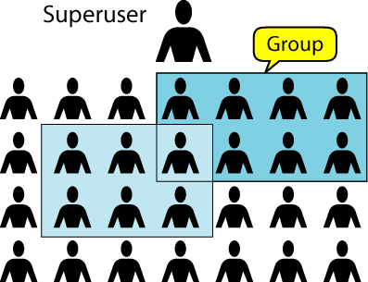
Figure 4-1
Users

Slide 4
Terminology
To find out group information, use the command named: groups user-id
Example: To find out what groups the user z036473 belongs to.
  ux% groups z036473
  student csci467a csci330c
Information about groups is stored in the Network Information Service (NIS) file named group.org_dir.

Slide 5
Security Levels
There are three levels of security in UNIX: system, directory and file.
System security – controlled by the system administrator, a super user.
Directory and file – controlled by the user who owned them.

Slide 6
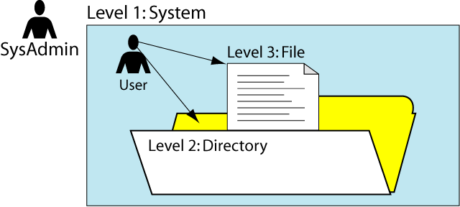
Figure 4-3
Security Levels

Slide 7
Access Permission Code
The protection on a file is referred to as its file modes
File modes are set with the “chmod” command
UNIX supports three types of access permissions:
  r read
  w write
  x execute
  - permission denied

Slide 8
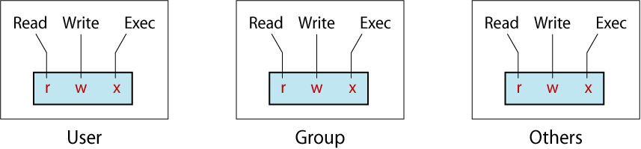
Figure 4-5
Directory and File Permissions

Slide 9
Access Types
Access Type | Meaning on File | Meaning on Dir.
r (read) | View file contents (open, read) | List directory contents
w (write) | Change file contents | - Change directory contents - Be careful !!!
x (execute) | Run executable file | - Make it your cwd - Access files (by name) in it
- | Permission denied | Permission denied

Slide 10
Checking Permissions
To check the permissions of an existing file or an existing directory, use the command: ls –l
Example:
  ux% ls –l unix
  total 387
  drwxr--r-- 1 z036473 student 862 Feb 7 19:22 unixgrades
  -rw-r--r-- 1 z036473 student 0 Jun 24 2003 uv.nawk
  -rw-r--r-- 1 z036473 student 0 Jun 24 2003 wx.nawk
  -rw-r--r-- 1 z036473 student 0 Jun 24 2003 yz.nawk

Slide 11
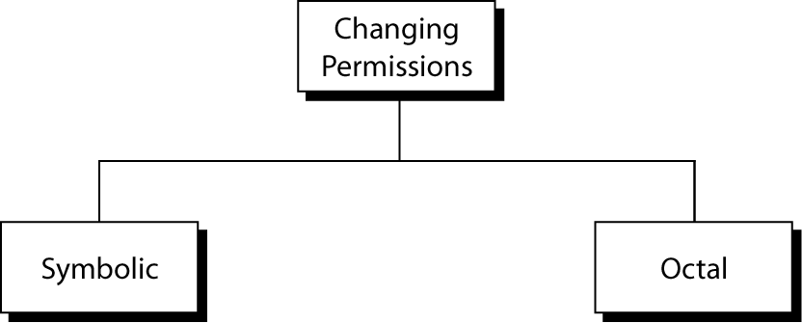
Figure 4-7
Changing Permissions

Slide 12
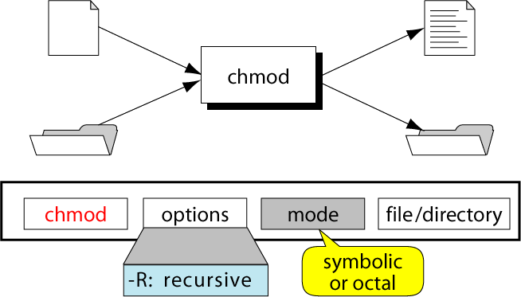
Figure 4-6
The chmod Command

Slide 13
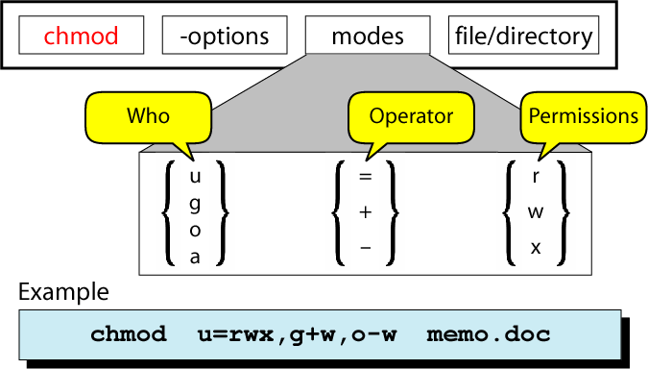
Figure 4-8
Changing Permissions: Symbolic Mode

Slide 14
Changing Permissions: Symbolic Mode
mp% chmod who operation permissions filename
u for user
g for group
o for others
a for all
+ for add
- for remove
= for assign
r for read
w for write
x for execute

Slide 15
Changing Permissions: Symbolic Mode
ux% ls -li sort.c
118283 -rw-r--r-- 1 krush csci 80 Feb 27 12:23 sort.c
Example 1: To change the permissions on the file “sort.c” using
Symbolic mode, so that:
Everyone may read and execute it
Only the owner and group may write to it.
We want this using symbolic mode:
rwx|rwx|r-x
Answer:
chmod ug=rwx,o=rx sort.c
chmod ugo+rx,go+w sort.c

Slide 16
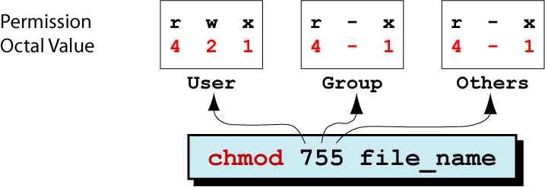
Figure 4-9
The chmod Command: Octal Mode

Slide 17
Changing Permissions: Octal Mode
ux% ls -li sort.c
118283 -rw-r--r-- 1 krush csci 80 Feb 27 12:23 sort.c
Example 2: Ignoring the original permission settings, change the
permissions on the file “sort.c” using octal mode, so that:
Everyone may read and execute it
Only the owner and group may write to it.
We want this using octal mode:
rwx|rwx|r-x
Answer: chmod 775 sort.c

Slide 18
Changing Permissions: Octal Mode
ux% ls -li sort.c
118283 -rw-r--r-- 1 krush csci 80 Feb 27 12:23 sort.c
Step | Perform… | Settings
1 | List the desired setting
2 | Assign binary: 1 for access; 0 for no access
3 | List octal values for the corresponding binary 1’s
4 | Convert the octal values to a 3-digit number
5 | Write the command
rwx|rwx|r-x
111|111|101
421|421|401
775
chmod 775 sort.c

Slide 19
Changing Permissions: exercise
Ignoring the original permission settings on a file called “myfile”, assign:
  Read, write, and execute permissions to owner
  Read and execute permissions to group
  Execute permission to others
We want: rwx|r-x|--x
1) Using Symbolic Mode: __________________________________
2) Using Octal Mode: __________________________________
chmod u=rwx,g=rx,o=x myfile
chmod 751 myfile

Slide 20
User Masks (default permissions)
The default permissions are initially set for a file or directory using a three-digit octal system variable called user mask (mask).
This user mask was defined initially by the system administrator when your account is created.
Initially set by system administrator in a start-up file: $HOME/.cshrc
The user mask contains the octal settings for the permissions to be removed from the default when a directory or file is created.
The default permissions are:
  777 for a directory
  666 for a file

Slide 21
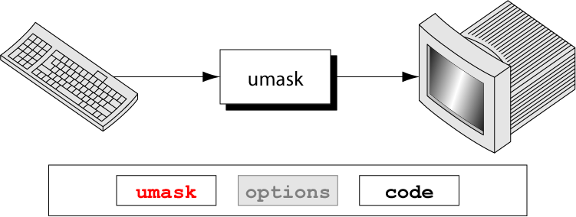
Figure 4-10
The umask Command

Slide 22
User Mask
User mask Value | Directory Default: 777 | File (666) Default: 666
000 | 777 (rwx rwx rwx) | 666 (rw- rw- rw-)
111 | 666 (rw- rw- rw-) | 666 (rw- rw- rw-)
222 | 555 (r-x r-x r-x) | 444 (r- - r- - r- -)
333 | 444 (r- - r- - r- -) | 444 (r- - r- - r- -)
444 | 333 (-wx –wx –rx) | 222 (-w- -w- -w-)
555 | 222 (-w- -w- -w-) | 222 (-w- -w- -w-)
666 | 111 (- -x - -x - -x) | 000 (--- --- --- )
777 | 000 (--- --- --- ) | 000 (--- --- --- )

Slide 23
The command: umask
% umask 000
For regular files: rw-rw-rw- 666
For directories: rwxrwxrwx 777
In $HOME/.cshrc file: umask 022
For regular files: rw-r- - r- - 644
For directories: rwxr-xr-x 755

Slide 24
Default Access Permissions
To prevent cheating, do not grant read and write access permissions to group and others!
Set default permissions for all files and directories created in the future, so that only you/owner can rw to it (rw- --- ---)
In your $HOME/.cshrc file: umask 077

Slide 25
Default Access Permissions: exercise
Assume your $HOME/.cshrc file contains the command: umask 002.
What permissions would be set for newly created text files?
b) What permissions would be set for newly created directories?

Slide 26
Special Permissions
The regular file permissions (rwx) are used to assign security to files and directories.
Three additional special permissions can be optionally used on files and directories.
  Set User Id (SUID)
  Set Group ID (SGID)
  Sticky bit

Slide 27
Special Permissions: SUID
SUID enables regular users to execute a program file and become the owner of the file for the duration of execution.
Example: The “passwd” command is used to change a user’s password. The file “/usr/bin/passwd” (owned by “root”) has this special permission set: r-sr-sr-x
In theory, only the root user has the ability to change passwords. Since “/usr/bin/passwd” has the SUID permission on, when a regular user executes the “passwd” command, the user temporarily becomes the “root” user while the “passwd” command is executing.

Slide 28
Special Permissions: GUID
Like SUID, SGID enables regular users to execute a program file and become a member of the group that is attached to the file.
If a file is owned by the system group and also has the SGID permission, then any user who executes that file will be a member of the system group during the execution.

Slide 29
Special Permissions: Sticky Bit
Sticky bit performs a useful function on directories
Recall: Write permission applied to a directory enables you to add and remove any files to or from that directory.
If you had “write” permission to a certain directory but no permissions for files within it, you could delete all of those files.

Slide 30
Special Permissions: Sticky Bit
Scenario: A company provides a common directory that gives all employees the ability to add and remove files in it. This directory must give user “write” permissions. Unfortunately, the “write” permissions also gives all employees the ability to delete all files and subdirectories within it, including the ones that others have added to the directory.

Slide 31
Special Permissions: Sticky Bit
If the “sticky” bit were applied to this common directory, in addition to “write” permissions, then employees may add files to the directory. However, they may delete only files and directories that they have added/created.
Example:
  ls –ld /tmp
  drwxrwxrwt 3 root sys 1077 Jan 25 13:30 /tmp
Sticky Bit

Slide 32
Special Permissions
The access permission status that is displayed using the “ls –l” command does not have a section for special permissions
However, since special permissions required “execute”, they mask the execute permission when displayed using the “ls –l” command.
r w x r w x r w x
r w s r w s r w t
SUID
SGID
STICKY
BIT

Slide 33
Special Permissions
All special permissions also required the “execute” permission to work properly.
Usually, the SUID and SGID apply to executable files.
The sticky bit applies to directories, which must have execute permission for access.
If special permissions are set on a file or a directory without “execute” permission, the special permissions are shown in capital letters.
r w - r w - r w -
r w S r w S r w T
SUID
SGID
STICKY
BIT

Slide 34
Setting Special Permissions
suid | sgid | stb | r | w | x | r | w | x | r | w | x
4 | 2 | 1 | 4 | 2 | 1 | 4 | 2 | 1 | 4 | 2 | 1
7 |  |  | 7 |  |  | 7 |  |  | 7
Special |  |  | user |  |  | group |  |  | others
Use the “chmod” command with octal mode:
chmod 7777 filename

Slide 35
Special Permissions: Exercise
Give the full UNIX command to enable all users including others to add files to directory named “dir1”, but only to delete files that they own in that directory.
Answer:
  ____________________________________
chmod 1777 dir1
Notes:
Access Permissions
Copyright Department of Computer Science, Northern Illinois University, 2004
Solution: chmod 1777 dir1

Slide 36
Q & A
Notes:
Access Permissions
Copyright Department of Computer Science, Northern Illinois University, 2004

